Slide 1




.
.
2023.10.15
.
Reliability Assessment of the Self Perceptual Matching Task as a Measurement of the Self-Prioritization Effect
Zheng Liu, Mengzhen Hu, Yuanrui Zheng, Jie Sui, Chuan-Peng Hu*
*
Notes:
题目

Slide 2
Outline
Background
Self-Prioritization Effect
Self Perceptual Matching Task
The Reliability Paradox
Method
Results
Discussion & Implication

Slide 3
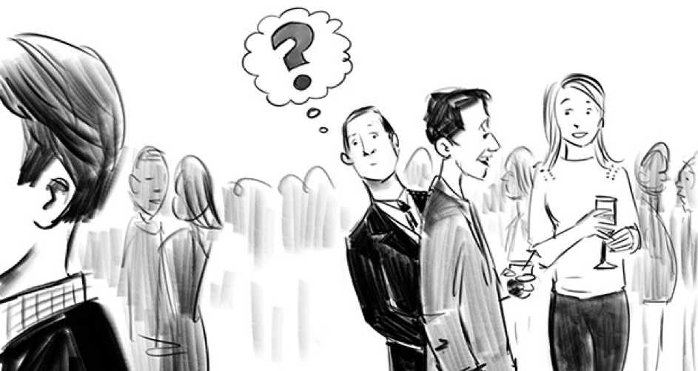
The Self-Prioritization Effect (SPE)
A memory advantage in recalling information encoded with self-relevance compared with those encoded with non-self relevance.
Despite SPE is often argued to be a self-specific effect, it has been challenging to be disassociated from familiarity effect.
The Cocktail Party Effect (Cherry, 1953 )

Slide 4
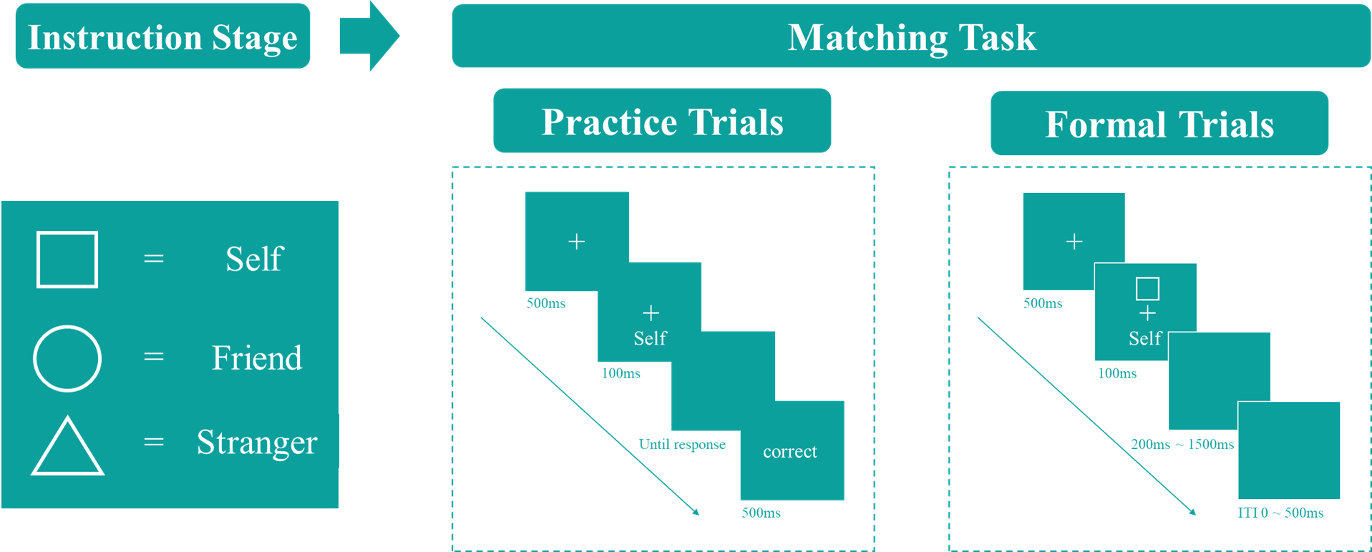
The Self Perceptual Matching Task (SPMT)
Sui et al. (2012) introduced the Self-Perceptual Matching Task (SPMT), where the self-relatedness (and other-relatedness) was acquired in the lab.

Slide 5
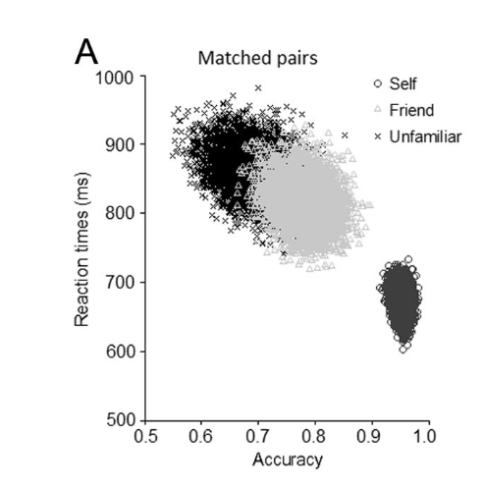
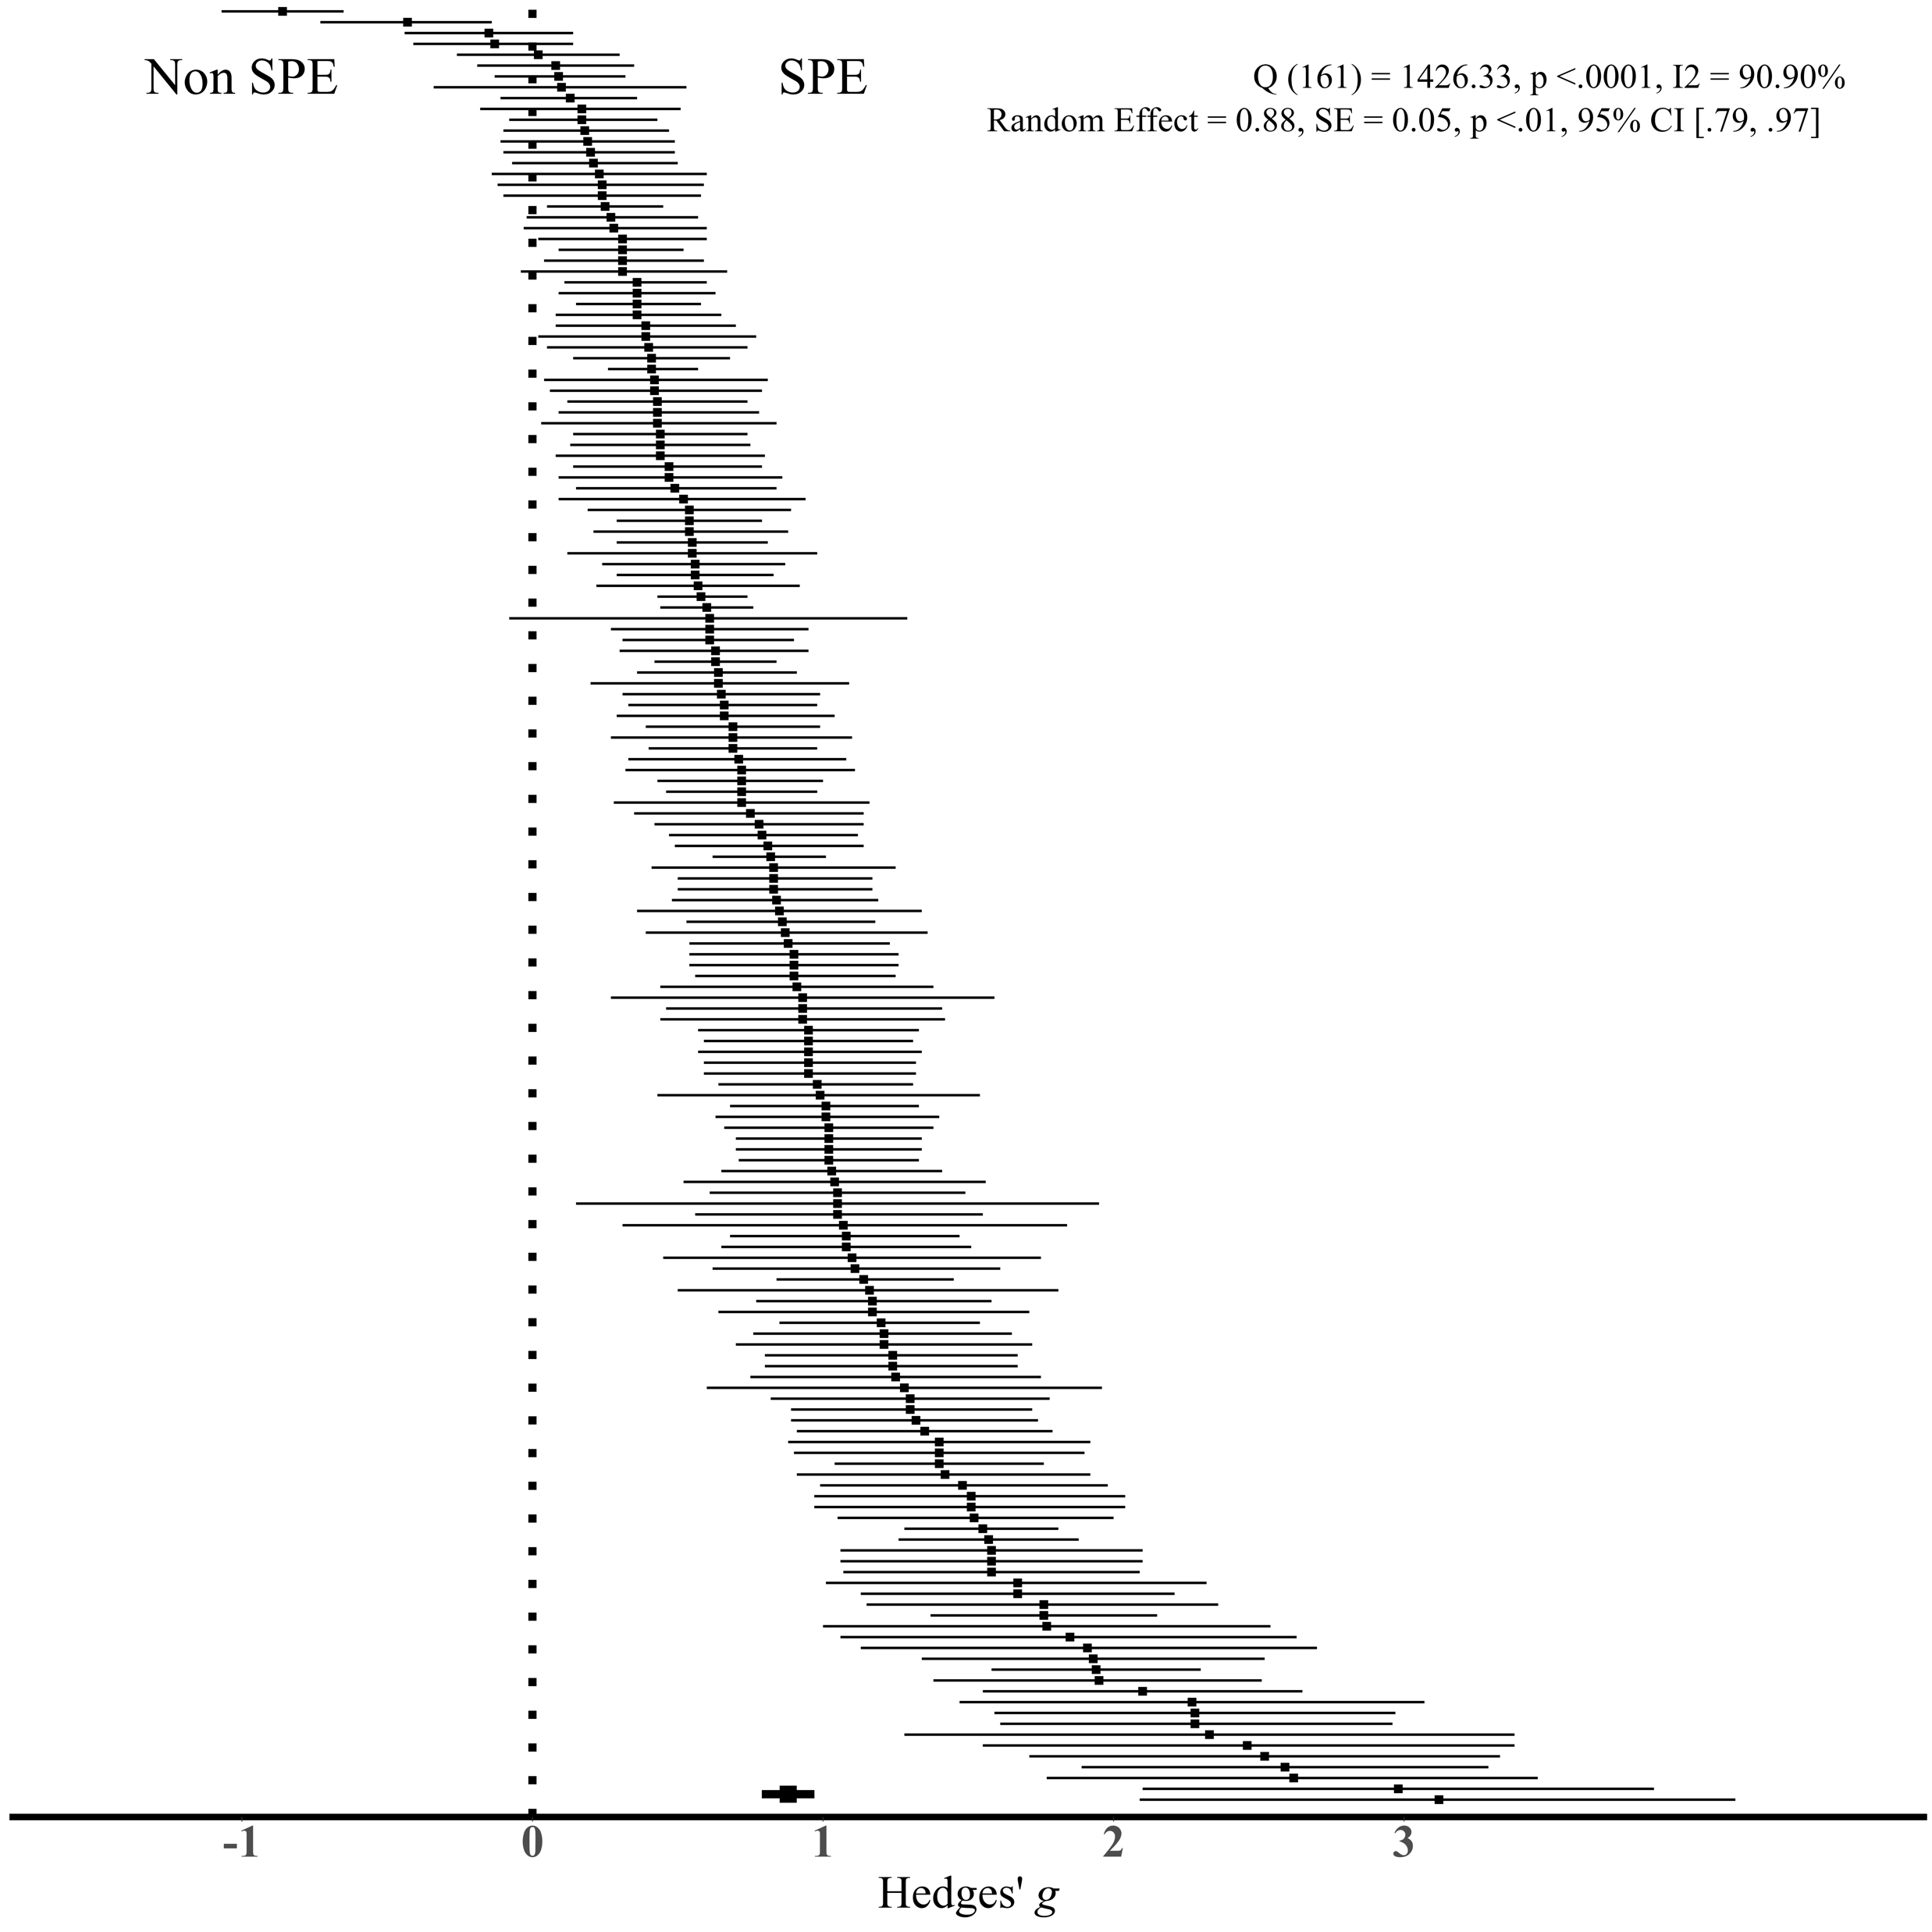
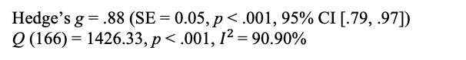
SPE in SPMT
A typical pattern from this task is that shapes associated to the self exhibit a response advantage over shapes related to others in the matching pairs.
Hedge’s g = .88 (SE = 0.05, p < .001, 95% CI [.79, .97])
Q (166) = 1426.33, p < .001, $I^{2 }$= 90.90%
Sui et al. (2012), J. Exp. Psychol.: Hum. Percept.
Liu, Hu, Hu, & Sui, (2023), PsyArXiv

Slide 6
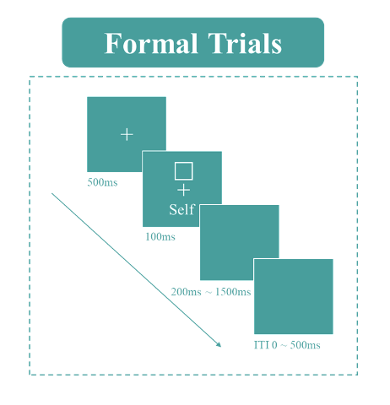
Variability in Quantifying SPE using SPMT
Variability in Indicators:
Two direct outcomes are generated from SPMT: Reaction Times (RT) and Choices. Several other indicators can be derived:
Reaction Time
v, z from DDM
Efficiency
Accuracy
Choice
d-prime from SDT
Variability in Baseline:
“Close other” (e.g., Friend), “Stranger”, “Celebrity” (e.g., “LuXun”) and “Non-person” (e.g., None).
Which way of quantifying SPE is the most reliable one(s)?

Slide 7
The Reliability Paradox
“Two Disciplines of Scientific Psychology” (Cronbach,1957)
Correlational Psychology -> Self-Report Questionnaires
Strong focus on reliability, psychometric thresholds for what makes a “good” scale.
A scale is good if it could consistently and dependably producing consistent results for the same person across sessions or times.
Experimental Psychology -> Behavioural Tasks
Strong focus on the “robustness of the experimental effects”.
A cognitive task is robust if it could consistently produces the same effect at the group level across various independent samples.

Slide 8
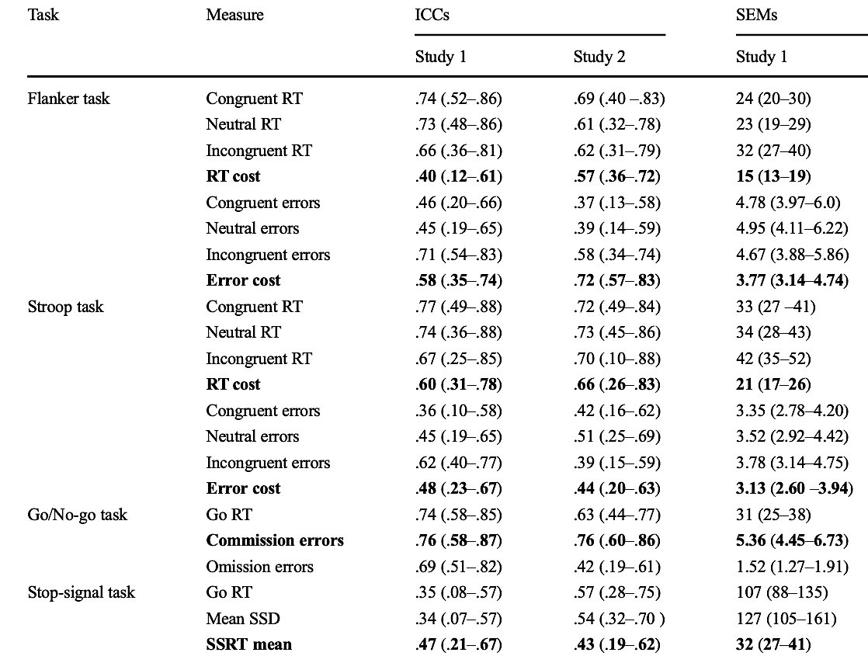
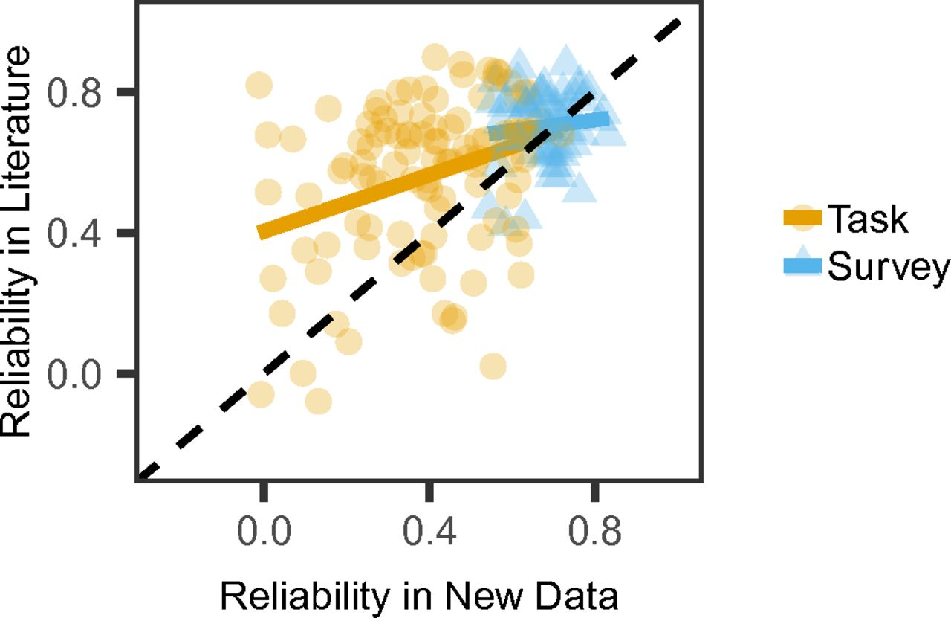
The Reliability Paradox
While cognitive tasks yield consistent experimental effects, they do not exhibit the same reliability when assessing individual differences (Logie et al., 1996).
Hedge et al., (2018), BRM
Enkavi et al., (2019), PNAS

Slide 9
Why is the Reliability of Cognitive Tasks a Problem?
Behavioral Measurement are poorly suited for individual difference research
Limits research in, e.g., clinical settings, brain imaging studies.
Problematic for researchers searching an association with data from questionnaires.

Slide 10
The Current Study
Research Questions
Given the variability of indicators (RT, ACC, d′, η, v, z) and choice of baseline conditions (“Close other”, “Stranger”, “Celebrity”, and “Non-person”), which way of quantifying SPE is the most reliable one(s)?
Is the SPE measured by SPMT suitable for assessing individual differences?

Slide 11
Method
Re-analyzed 17 independent datasets (N = 805) from 9 papers and 2 unpublished projects that employees SPMT.
Analysis plans for this study were preregistered on OSF (https://osf.io/pcv3u/).
Roadmap of the current study

Slide 12
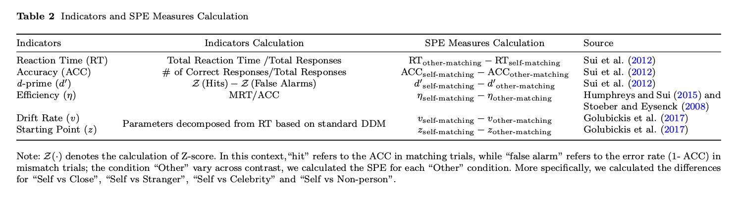
Analysis
Calculating the Indicators and SPE Measures
Estimating the Robustness of SPE
Meta-analytical assessments using random effects model.
Hedges’ g for effect size index.

Slide 13
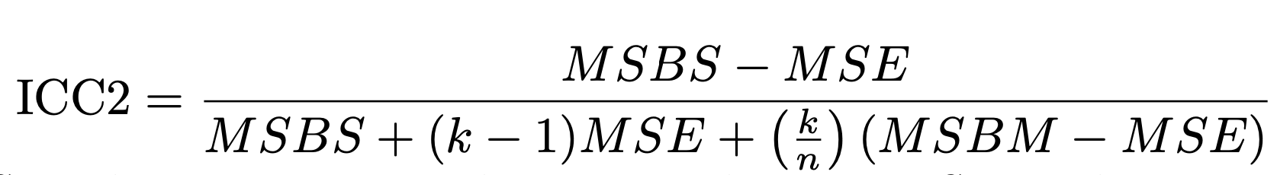
Estimating the Reliability of SPE
Split-half Reliability
First splitting the trial-level data into two halves (using Four data splitting approaches: first-second, odd-even, permutated, and Monte Carlo) and calculating the Pearson correlation coefficients.
Weighted the coefficients based on the trial numbers of each study since the number of trials typically significantly influences the reliability of cognitive tasks (Kucina et al., 2023).
Test-retest Reliability
Intraclass Correlation Coefficient, Two-way Random Effect Model
The proportion of total variance in measurements that is attributed to between-subjects variability (individual differences) and within-subjects variability (variability due to repeated measurements)
MSBS: mean square between subjects
MSE: mean square error
MSBM: the mean square between measurements
K: number of measurements
n is number of participants

Slide 14
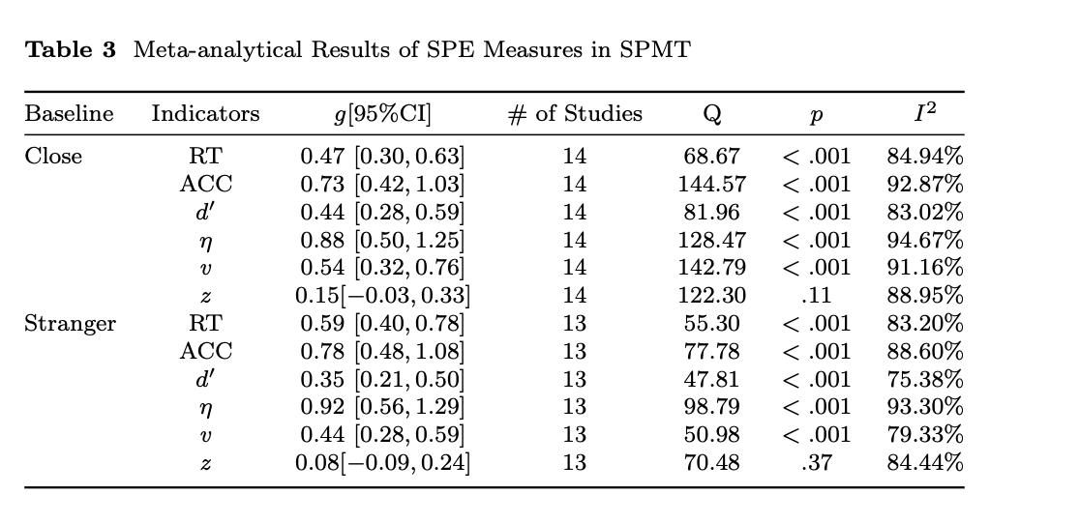
Results
Estimating the Robustness of SPE
14 of datasets contain data for the Close other, 13 of datasets contain data for Stranger, 1 dataset has the data for Celebrities, 1 has the data for Nonperson
We found that all measures of SPE, except the parameter z estimated from DDM, exhibited moderate to large effect sizes, indicating a robust and substantial experimental effect of SPE.

Slide 15
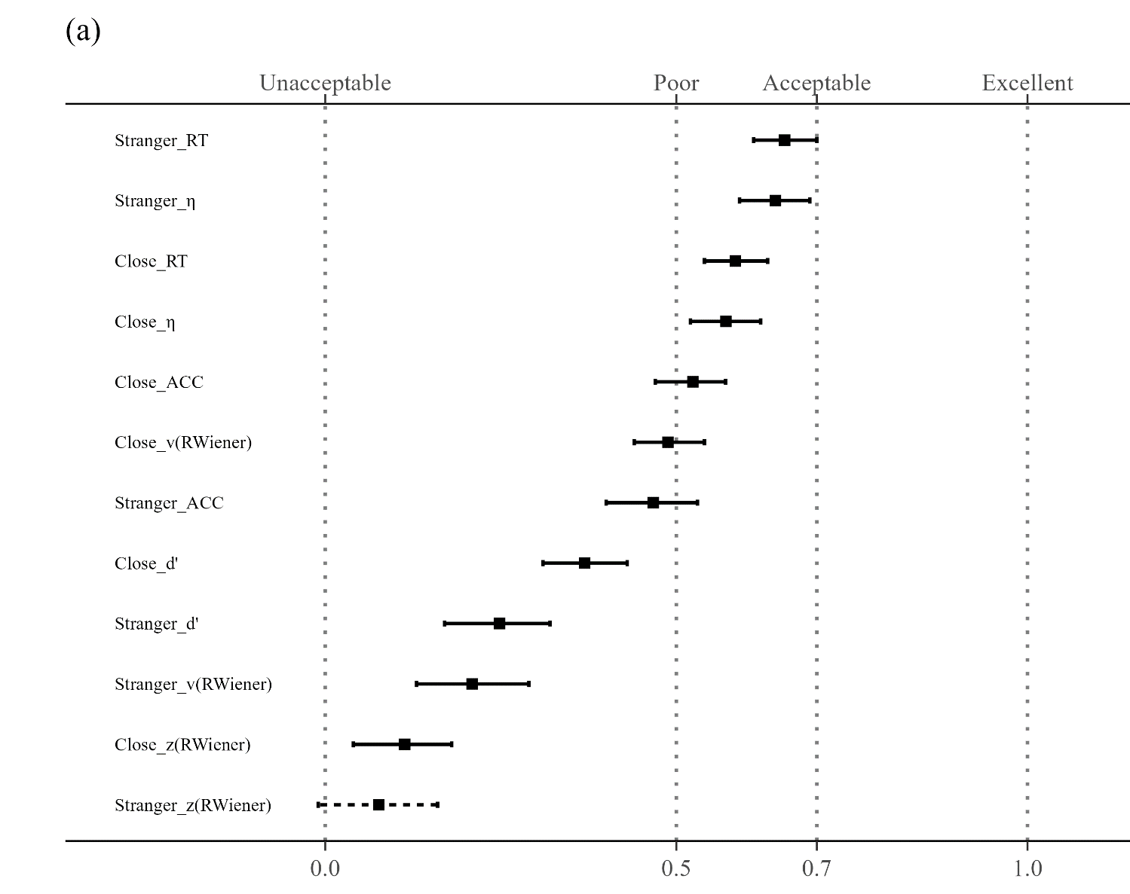
Split-half Reliability of SPMT
The four with highest split-half reliabilities are as follows: Reaction Time (RT) with “Stranger” as baseline (r = .65, SE = .02, p < .001,95%CI [.61, .70]); Efficiency (η) with “Stranger” as baseline (r = .64,SE = .03, p < .001, 95%CI [.59, .69]); RT with “Close other” as baseline (r = .58, SE = .02, p < .001, 95%CI [.54, .63]); η with “Close other” as baseline (r = .57, SE = .02, p < .001, 95% CI [.52, . 62]).
For all other SPE measures, the reliability is around 0.5 or lower, indicating poor reliability.
SHR with Monte Carlo split-half Method

Slide 16

Test-retest Reliability of SPMT
When using “Close other” as baseline, the ICC2 for SPE measured by RT was 0.53 (95% CI = [.39, .69]), and for Efficiency, it was 0.52 (95% CI = [.38, .68]).
When “Stranger” was used as baseline, the ICC2 for RT was 0.58 (95% CI = [.45, .73]), and for Efficiency, it was 0.35 (95% CI = [.21, .52]).
All other measures of SPE exhibited reliability lower than 0.5.

Slide 17
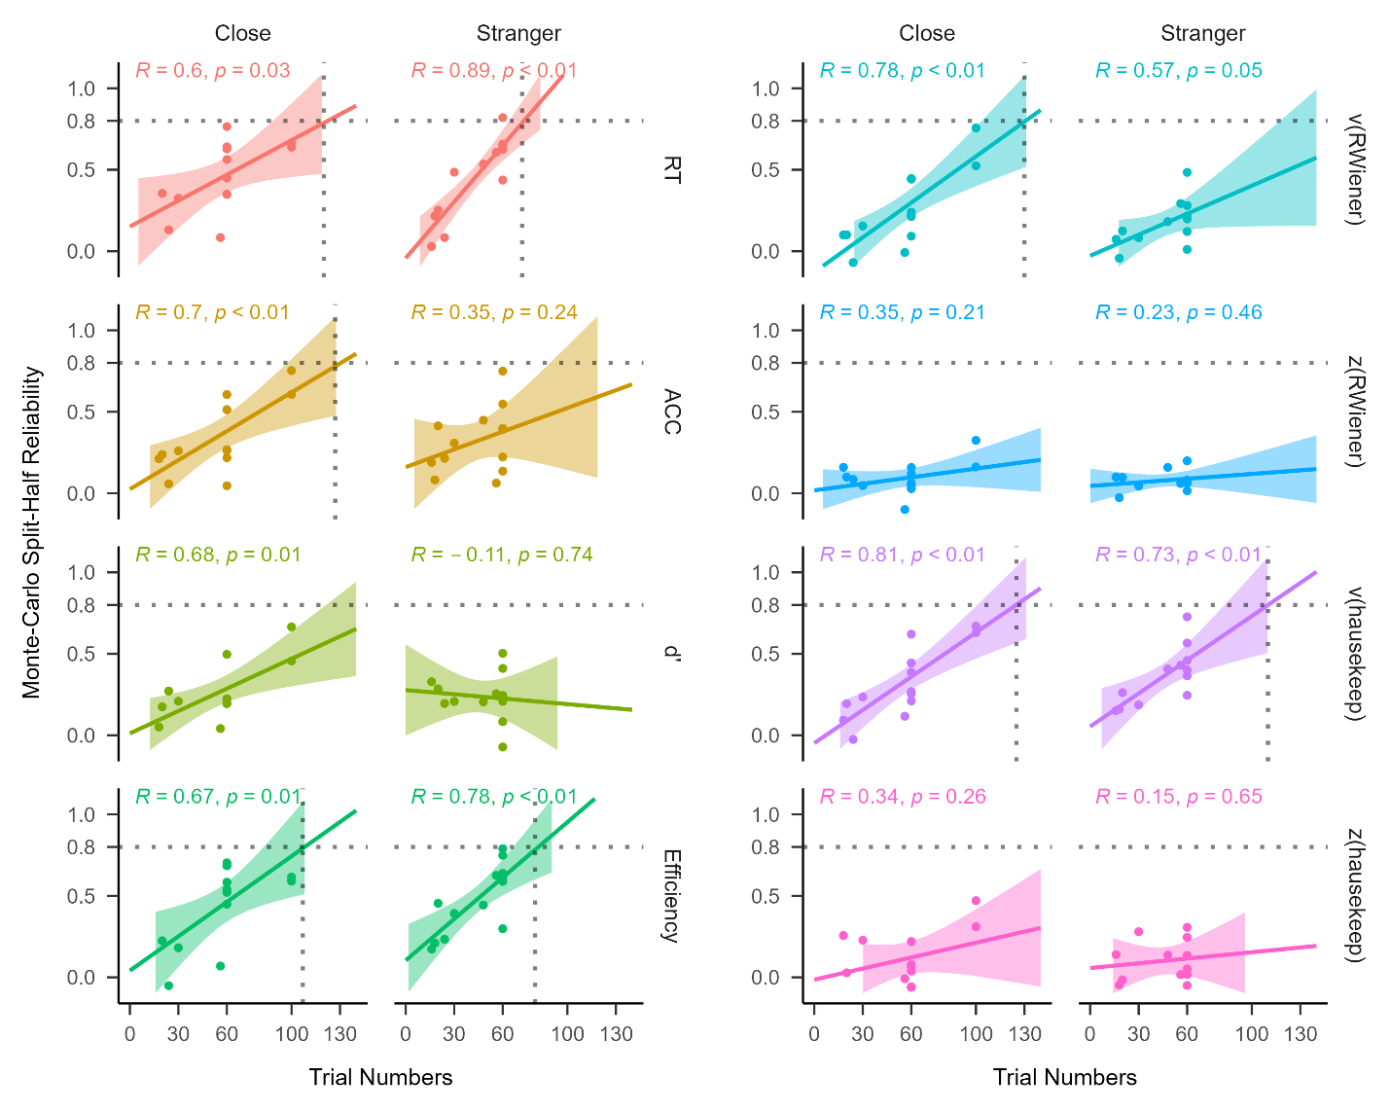
Exploratory Analysis
Significant correlations between trial numbers and Monte Carlo split-half reliability for some indicators, such as Reaction Time and Efficiency.
Non-significant correlations between g and split-half reliability, g and n trials.
Correlations between trial numbers and Monte Carlo split-half reliability

Slide 18
Discussion
Except parameters z from DDM, all the other measures exhibited robust SPE
When it came to the reliability, only two measures of SPE, Reaction Time and Efficiency, exhibited acceptable to moderate reliability, among all indicators that has been reported in the literature.
The current implementation of SPMT was not well-suited for assessing individual differences.
Taken together, our study revealed a “reliability paradox” of SPE as measured by SPMT.

Slide 19
Reaction Time and Efficiency are the Best Measures (Comparably) to Measure SPE
The reaction time and efficiency performed relatively well on both group-level and individual-level.
For different baseline conditions used for calculating SPE in the literature, “Stranger” produced slightly higher effect size for almost all the six indicators and demonstrated greater reliability when it came to reaction time.

Slide 20
The “Reliability Paradox” of SPMT
The majority of the SPE measures demonstrated moderate to large effect sizes when analysed at the group level. However, when considering individual differences, only the SPE measures derived from reaction times (RT) and Efficiency (η) displayed comparatively higher values than other SPE measures but still did not meet the criteria for a satisfactory reliability.
One of the most plausible explanations is that the SPMT, like other cognitive tasks, tends to exhibit minimal variability among participants while maximizing the detection of SPE at the group level.

Slide 21
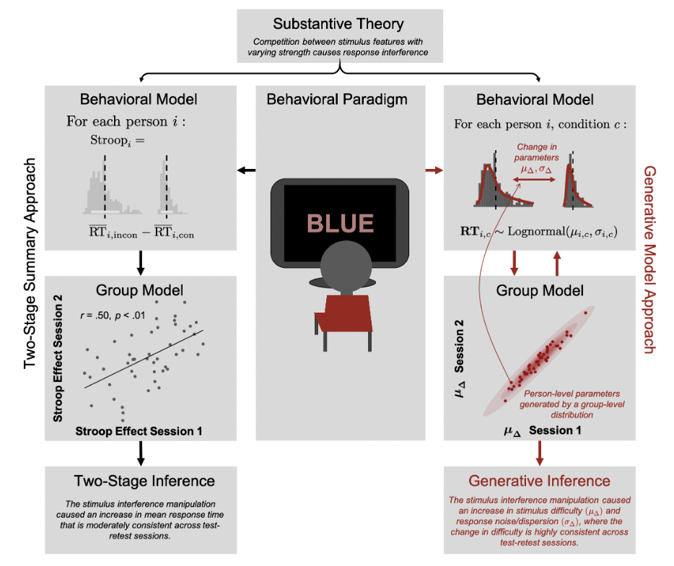
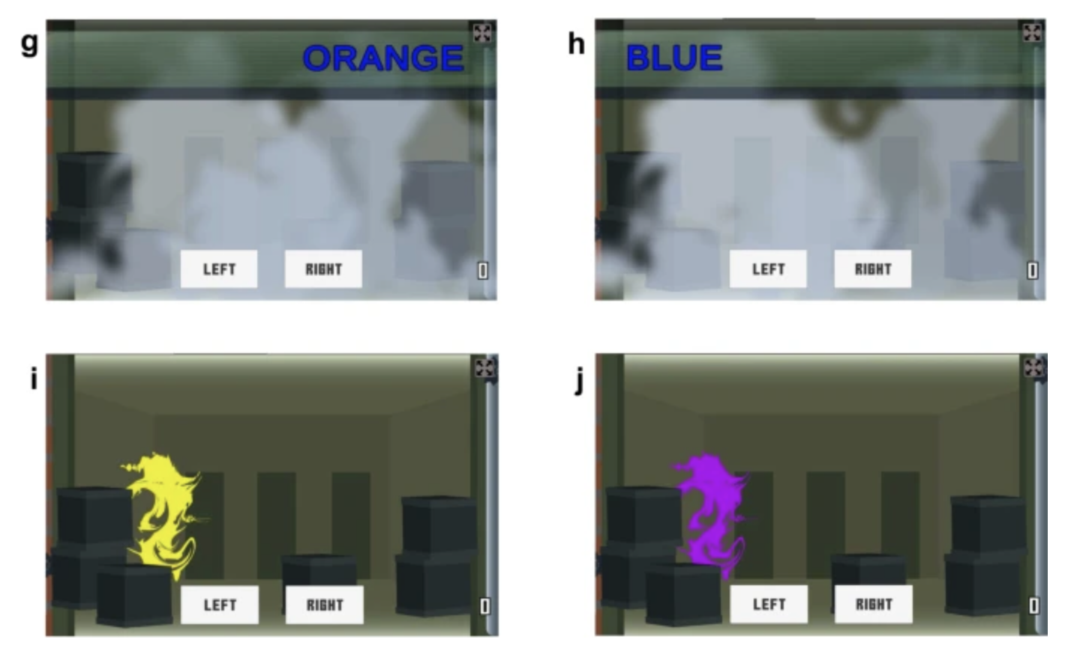
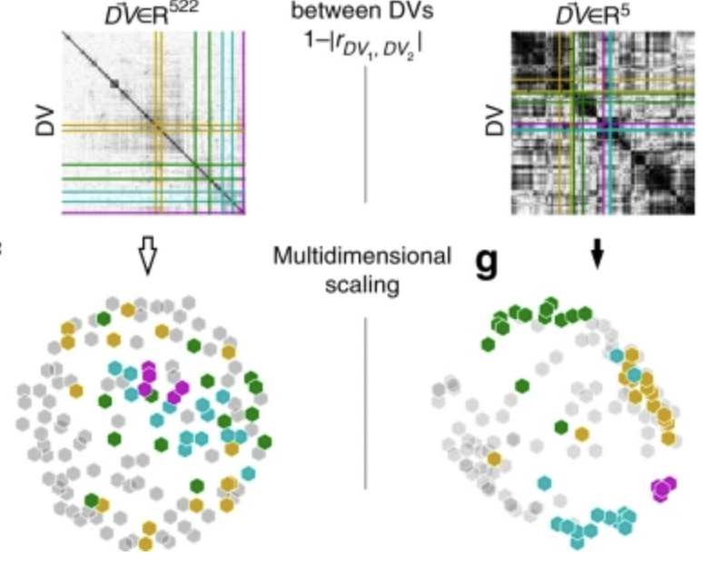
A Re-design of SPMT for Individual Differences
As the SPMT was designed to achieve robust group-level SPE rather than to measure individual differences, researchers need to re-design the task if they are interested in assessing individual difference.
Gamification of the Stroop Task
Kucina et al. (2023), Nature Communication
Using Generative Model
Haines et al., 2020)
Using Latent Model
Enkavi et al., (2019), PNAS
Eisenberg et al., (2019), Nature Communication

Slide 22
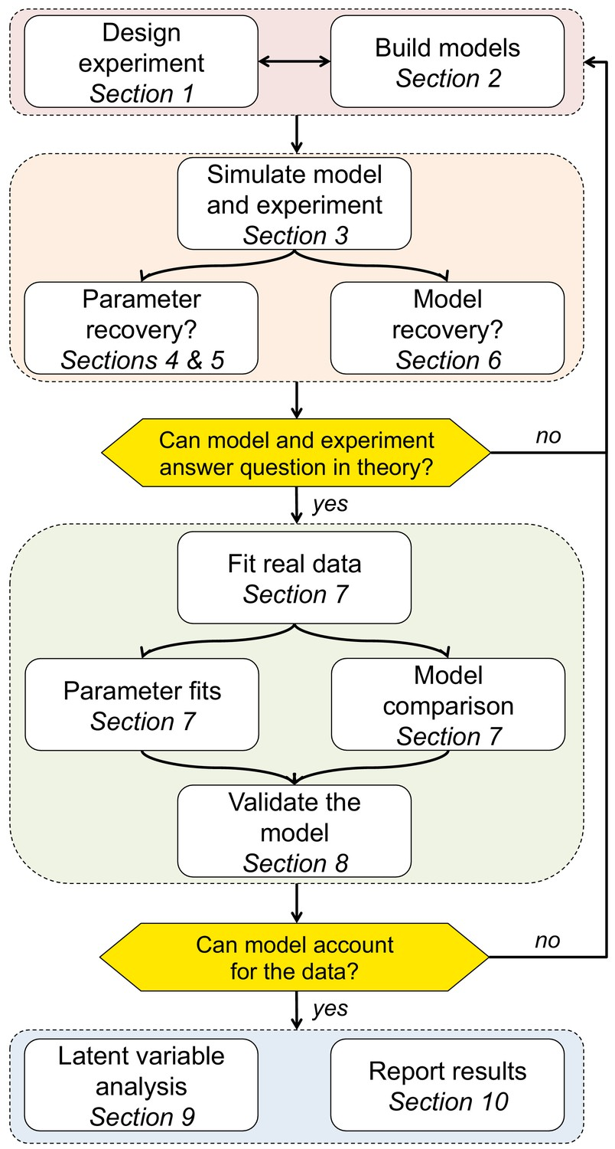
Low Reliability in the Parameters (v and z) from Standard DDM
The reliability of both the drift rate (v) and the starting point (z) fell well below acceptable levels.
Raised concerns about applying the standard drift-diffusion to data from SPMT directly.
Called for a more principled approach when modelling behavioural data to more accurately capture the fundamental cognitive processes at play.
Wilson and Collins (2019), Elife

Slide 23
Implication
An Initial Guide for Researchers Considering the Use of SPMT.
We recommend reaction times and efficiency as the indicators of SPE.
RT and efficiency strike a balance between achieving a substantial effect size at the group level and ensuring reliability at the individual level.
Considering the use of “Stranger” as baseline.
Increasing the number of trials is advisable.
Against the indiscriminate application of the standard DDM.
We advocate for a principled modelling approach.

Slide 24
Limitations
The majority of our samples still consisted of individuals from what is commonly referred to as “(W)EIRD” populations (Rad et al., 2018; Yue et al., 2023).
Necessary to include a more diverse sample to ensure greater generalizability of the paradigm.
The robustness and reliability of different variants of SPMT still need further investigation.
Only one dataset had longitudinal data available, which could potentially limit the representativeness of the ICC2 result.
Additional analysis of two datasets (in supplementary) that with different design showed similar results.

Slide 25
.
.
.
Thanks for Attention！
Any Questions?
*
Notes:
题目

